Slide 1

Enhanced SAP-1 Computer with Interactive Frontend
Course: CE222L | Faculty: Computer Science
Presented by
Mohammad Musa Ali
Sarosh Ishaq
Muhammad Umer

Slide 2
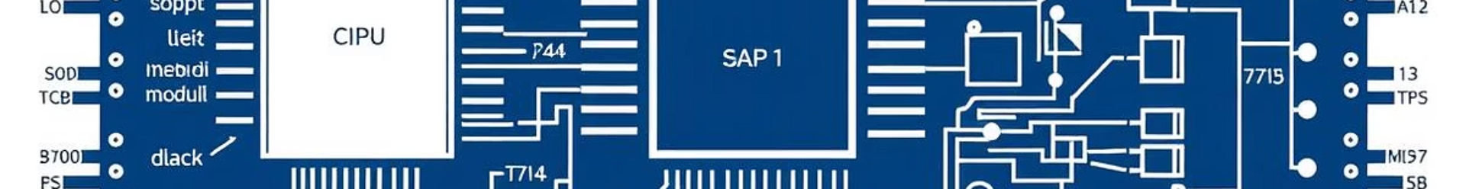
Introduction to SAP-1
What is SAP-1?
Simple 8-bit educational computer demonstrating von Neumann architecture
1. Core Components of SAP-1
Component
Role
Program Counter (PC)
Holds the memory address of the next instruction.
Memory (RAM)
Stores both instructions and data (8-bit words).
Instruction Register (IR)
Holds the current instruction (4-bit opcode + 4-bit operand).
Accumulator (ACC)
Stores intermediate results of calculations.
Arithmetic Logic Unit (ALU)
Performs math/logic operations (ADD, SUB, AND, etc.).
Control Unit (CU)
Decodes instructions and coordinates all components.
Output Register (OUT)
Displays the final result.

Slide 3



How Basic SAP-1 Works
Fetch
Program Counter reads memory to load instruction into IR
Decode
Control Unit interprets opcode for operation
Execute
ALU or Memory performs operations
Example: LDA 5 loads data at memory address 5 into ACC

Slide 4
Our Enhanced SAP-1 Model
Improvements
Benefits
Extended instruction set with 10 operations
Improved learning through visualization and hands-on interaction
Interactive web-based frontend
Real-time debugging features
Eases understanding of fundamental computer operations

Slide 5
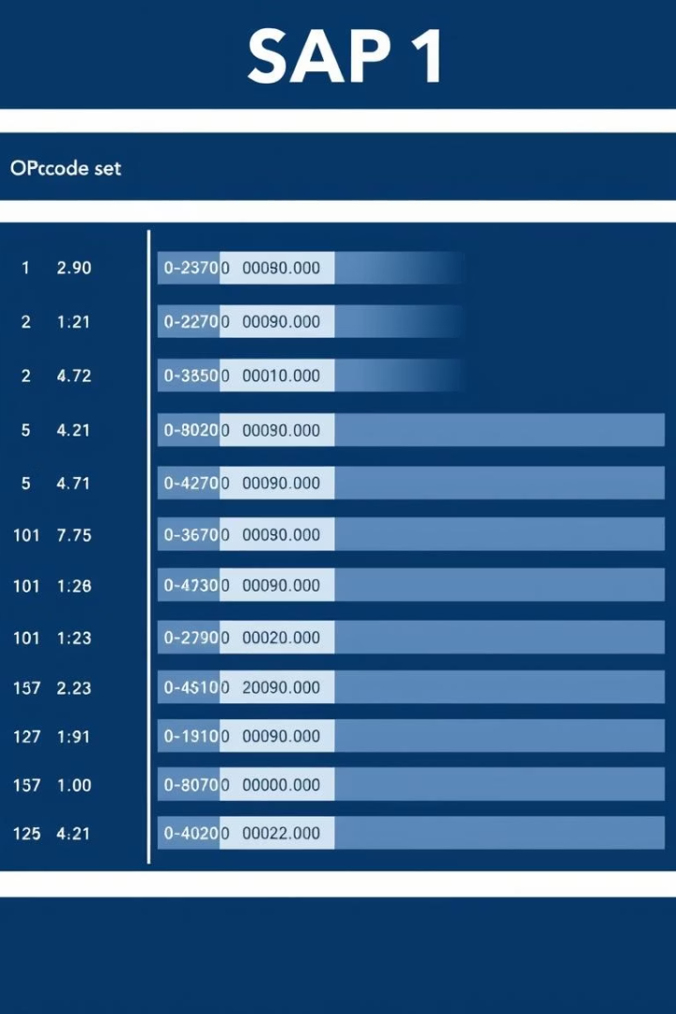
Enhanced SAP-1 Instruction Set
Opcode
Mnemonic
Function
Example
0000
LDA
Load value from memory to ACC
LDA 5
0001
ADD
Add memory value to ACC
ADD 3
0010
SUB
Subtract memory value from ACC
SUB 2
0011
AND
Bitwise AND with ACC
AND 4
0100
OR
Bitwise OR with ACC
OR 1
0101
XOR
Bitwise XOR with ACC
XOR 7
0110
JMP
Jump unconditionally to address
JMP 0
0111
JZ
Jump if ACC equals zero
JZ 8
1110
OUT
Output ACC value
OUT
1111
HLT
Stop CPU execution
HLT

Slide 6
Frontend Demonstration Features
Key Features
Highlights
Register viewer to monitor internal states
Current instruction highlighted dynamically
Step-by-step execution control
Visual updates of registers and output window
Waveform visualization for signal tracing

Slide 7
Technical Challenges & Educational Value
Challenges Faced
Our Solutions & Impact
Timing synchronization
JSON data protocol for smooth communication
Frontend-backend communication protocol
Enhanced accessibility and visualization
Memory initialization techniques

